Slide 1
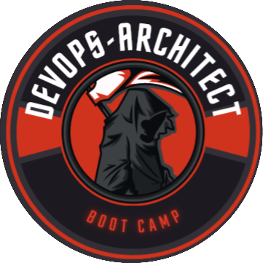
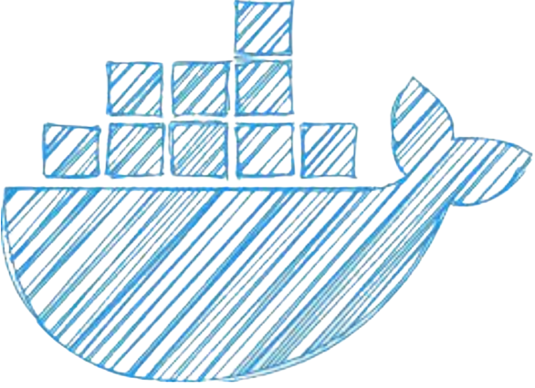
Introduction to Container's
Learn with Bilal : https://www.youtube.com/@bilalmazhar100
GitHub : https://github.com/BilalMaz/DevOps-Architect-BootCamp

Slide 2

About me
Hi there, my name is Bilal and I will Welcome you to DevOps boot camp! I am thrilled to have you join us for this exciting journey of learning and discovery.
In this boot camp, we will be exploring the principles and practices of DevOps, which is a set of methodologies and tools that aims to bridge the gap between software development and operations. DevOps is an increasingly important area in the field of software engineering, as it helps organizations to streamline their processes, improve their agility, and deliver better value to their customers.
By the end of this boot camp, you will have gained a comprehensive understanding of DevOps and its key concepts, as well as practical skills in areas such as infrastructure automation, continuous integration and delivery, monitoring and logging, and more. You will be equipped with the knowledge and tools to apply DevOps principles in your own work and contribute to the success of your organization.
I am always looking to connect with other professionals in the field, share ideas and insights, and stay up to date on the latest trends and developments. I welcome the opportunity to connect with you and explore ways in which we can collaborate and support each other.
GitHub : https://github.com/BilalMaz/DevOps-Architect-BootCamp
LinkedIn : https://www.linkedin.com/in/bilalmazhar-cyber-security-consultant/

Slide 3
What is container ?
Containerization is a method of OS virtualization that packages applications along with dependencies, libraries, and configurations into self-contained units called containers.
Containers provide lightweight and isolated environments, ensuring consistent application execution across different computing environments.
Key Features and Benefits:
Portability,
Scalability,
Efficiency,
Dependency Management,
Reproducibility.

Slide 4
Container Tools
Sr. | Tools | Description
1 | Docker | Docker is a widely adopted containerization platform that provides a comprehensive set of tools for building, managing, and deploying containers. It emphasizes ease of use and portability across different environments.
2 | Podman | Podman is an alternative container engine to Docker that focuses on providing a secure and lightweight container runtime. It offers a CLI-compatible interface with Docker and is designed to be daemon less.
3 | rkt | rkt (pronounced "rocket") is a container runtime developed by CoreOS. It aims to provide security, simplicity, and composability. rkt is known for its focus on security and its ability to run containers without a central daemon.
 | Contained | Contained is an open-source container runtime that provides a low-level interface for managing container execution and image distribution. It is designed to be embedded in higher-level container orchestration platforms.

Slide 5
Docker
Docker is a popular containerization platform that simplifies building, deploying, and managing containers,
Key Features:
Container Images,
Docker file,
Containerization,
Docker Engine,
Container Registry,
Docker Compose,
Docker Swarm
Docker enables easy application portability, scalability, and consistent deployment across environments.

Slide 6
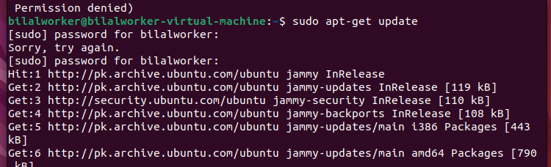
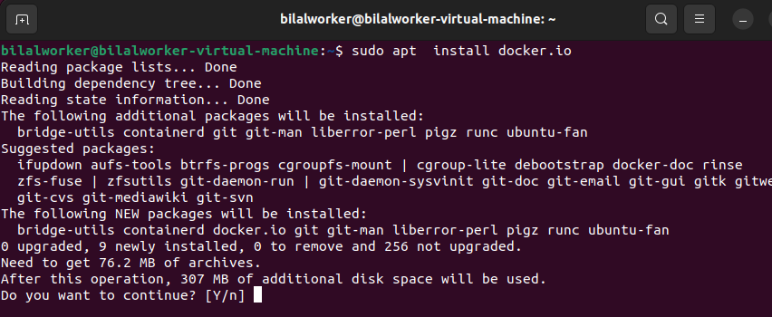
Docker Installation
Sudo apt-get update
Sudo apt-get install docker.io

Slide 7
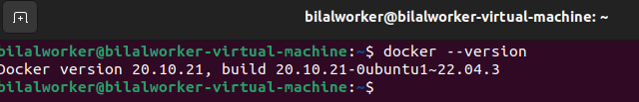
Docker Installation
docker --version

Slide 8
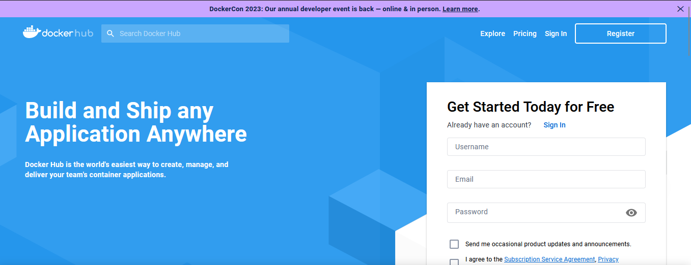
Docker Hub
https://hub.docker.com/

Slide 9
Docker basic Commands
Commands | Description
docker run | Creates and runs a new container from an image
docker start | Starts a stopped container
docker stop | Stops a running container
docker restart | Stops and starts a container
docker rm | Removes one or more containers
docker ps | Lists running containers
docker ps -a | Lists all containers (including stopped ones)
docker images | Lists available images
docker pull | Pulls an image from a registry to the local machine
docker push | Pushes an image to a registry
docker build | Builds a Docker image from a Dockerfile

Slide 10
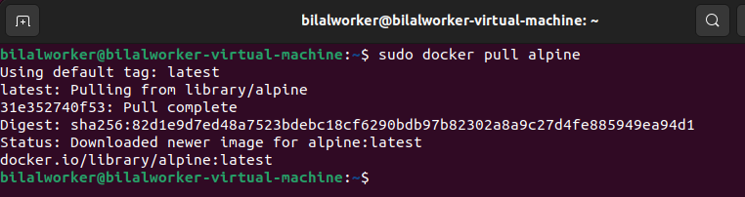
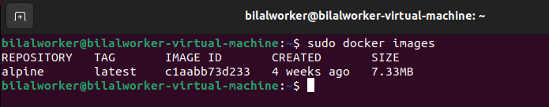
Lab 1 : Pull and Run a Linux Container
docker pull <linux_image_name>
sudo docker images

Slide 11
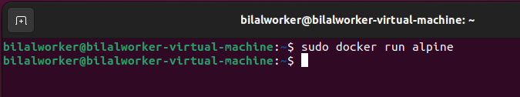
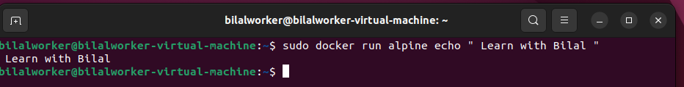
sudo docker run <container name>
sudo docker run alpine echo " Learn with Bilal "

Slide 12
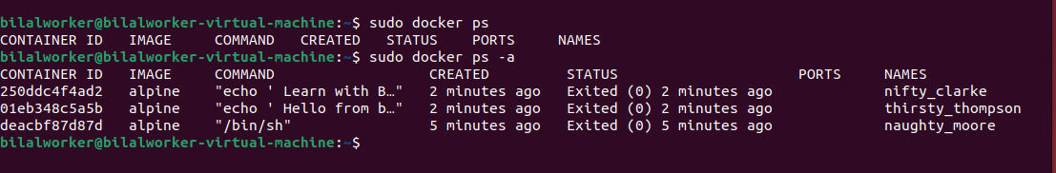

Docker process
sudo docker ps
sudo docker run -it alpine sh​

Slide 13
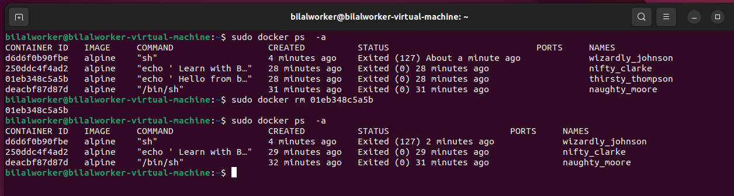
Docker remove
sudo docker ps -a
sudo docker rm <images ID >

Slide 14
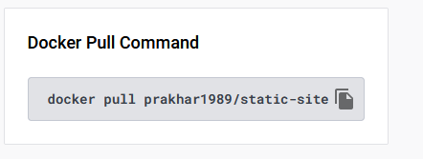
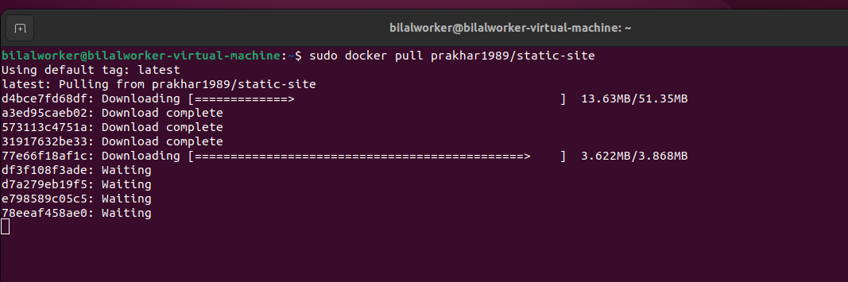
Lab 2 : Host a Static Website using Container
https://hub.docker.com/r/prakhar1989/static-site/
sudo docker pull prakhar1989/static-site

Slide 15
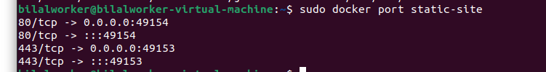
Lab 2 : Host a Static Website using Container
sudo docker run -d -P --name static-site prakhar1989/static-site
sudo docker port static-site

Slide 16
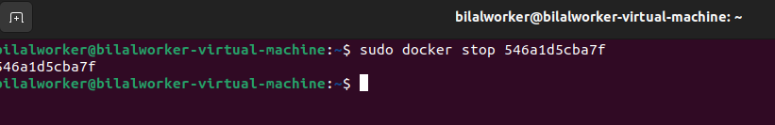
Static Docker " Stop "
Sudo docker ps
sudo docker stop 546a1d5cba7f

Slide 17
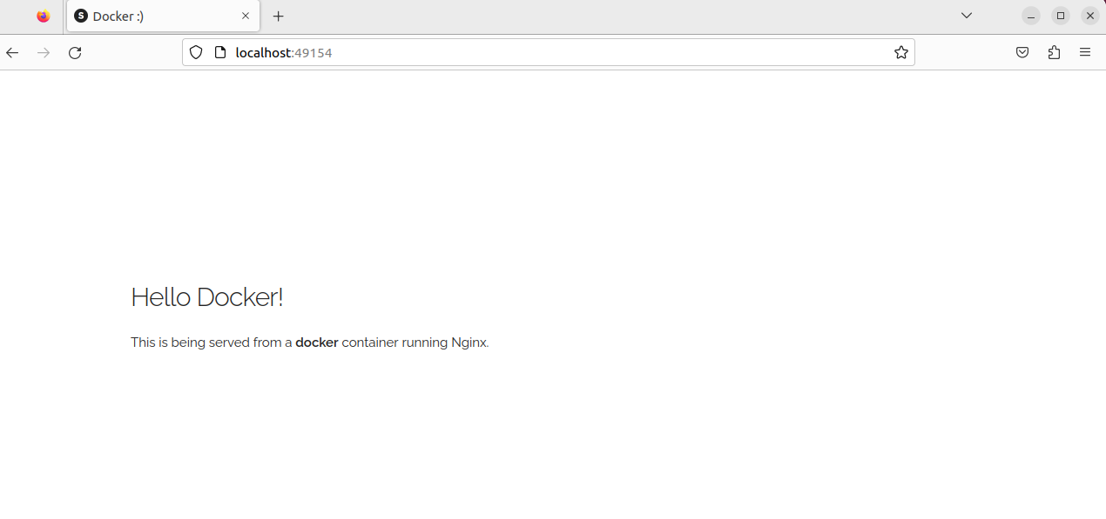
Static website running from Container !

Slide 18
Docker file
A Dockerfile is a simple text file that contains a list of commands that the Docker client calls while creating an image. It's a simple way to automate the image creation process. The best part is that the commands you write in a Docker file are almost identical to their equivalent Linux commands. This means you don't really have to learn new syntax to create your own docker file
Docker file ready, you can build an image using the docker build command and the -f flag to specify the path to the Docker file. For example:​
​
​
" docker build -t <image name> -f /path/to/Dockerfile "
Replace <image name> with the desired name for your image.​

Slide 19
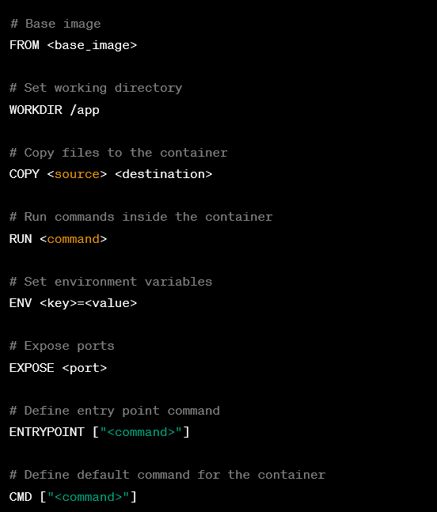
Sample Docker file
Tag | Description
FROM | Specifies the base image for the new image
WORKDIR | Sets the working directory inside the container
COPY | Copies files and directories from the host system to the container
ADD
RUN | Executes commands inside the container during the build process
ENV | Sets environment variables for the container.
EXPOSE | Declares the ports that the container listens on at runtime.
ENTRYPOINT | Specifies the command that is run when the container starts
CMD | sets the command to be executed when the container starts.

Slide 20
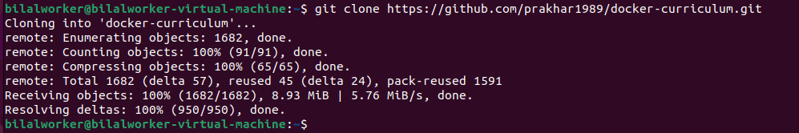
Let's create " Apna " ( Own ) Container
Now that we have a better understanding of images, it's time to create our own. Our goal in this section will be to create an image that sandboxes a simple Flask application
$ git clone https://github.com/prakhar1989/docker-curriculum.git

Slide 21
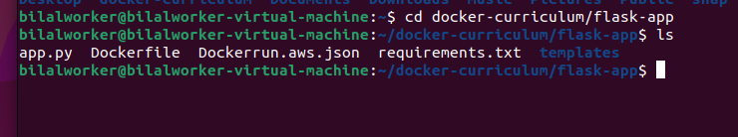
Let's create " Apna " ( Own ) Container
$ Ls
$ cd docker-curriculum/flask-app
The next step now is to create an image with this web app. As mentioned above, all user images are based on a base image. Since our application is written in Python, the base image we're going to use will be Python 3.

Slide 22
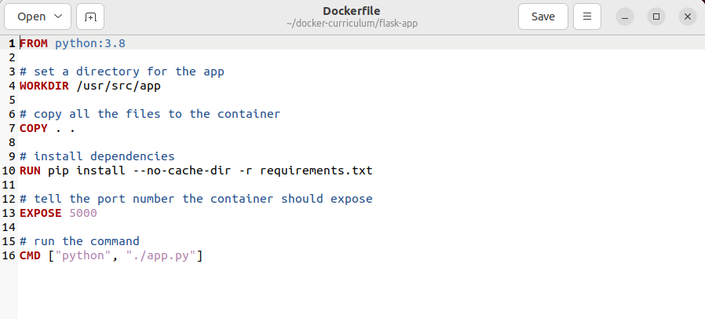
Docker file

Slide 23

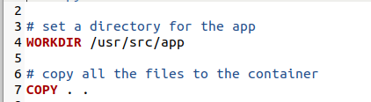
Docker Explain
We start with specifying our base image. Use the FROM keyword to do that -
The next step usually is to write the commands of copying the files and installing the dependencies. First, we set a working directory and then copy all the files for our app.

Slide 24


Docker Explain
Now, that we have the files, we can install the dependencies.
The next thing we need to specify is the port number that needs to be exposed. Since our flask app is running on port 5000, that's what we'll indicate.

Slide 25

he last step is to write the command for running the application, which is simply - python ./app.py. We use the CMD command to do that -
The primary purpose of CMD is to tell the container which command it should run when it is started. With that, our Docker file is now ready.

Slide 26
Docker Creation " Build "
Now that we have our Docker file, we can build our image. The docker build command does the heavy-lifting of creating a Docker image from a Docker file.
" docker build [OPTIONS] PATH "
-t, --tag: Specifies the name and optional tag for the image. It allows you to provide a human-readable name and version for the image. For example, -t myapp:1.0 would tag the image as myapp with version 1.0.
-f, --file: Specifies the path to the Docker file if it is not in the default location (i.e., ./Docker file in the build context).
--build-arg: Allows you to set build-time variables used in the Docker file. You can pass key-value pairs to set values during the build process.
--no-cache: Forces the build process to ignore the cached intermediate layers from previous builds, ensuring a clean build from scratch.
--pull: Forces the command to always attempt to pull a newer version of the base image before starting the build.

Slide 27
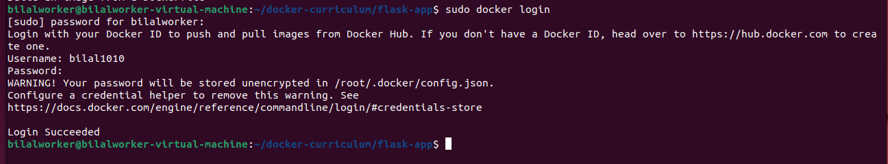
Docker login
sudo docker login
Enter Username and password ( if not create docker hub login @ https://hub.docker.com/

Slide 28
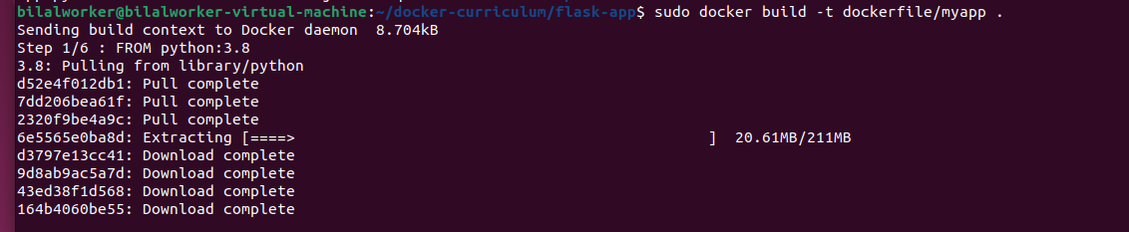
Docker Creation " Build "
sudo docker build -t dockerfile/myapp .

Slide 29
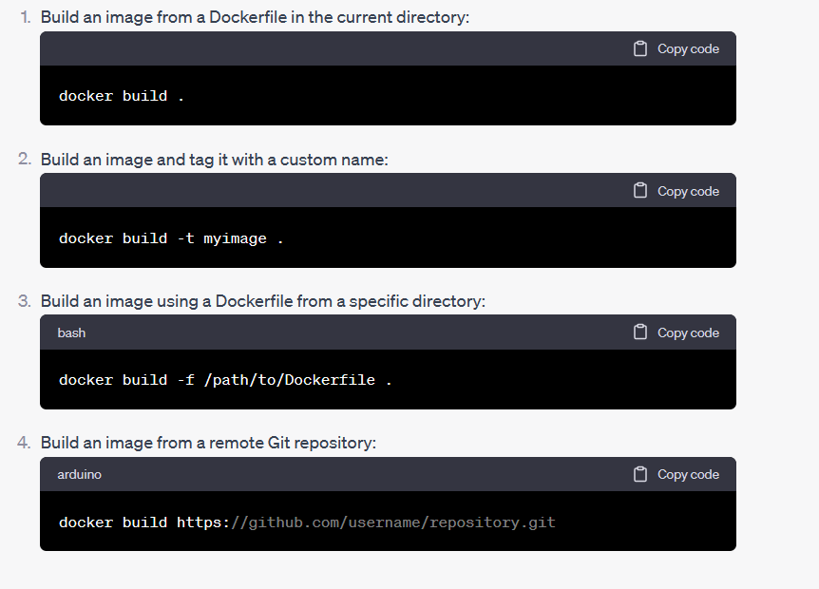

Slide 30
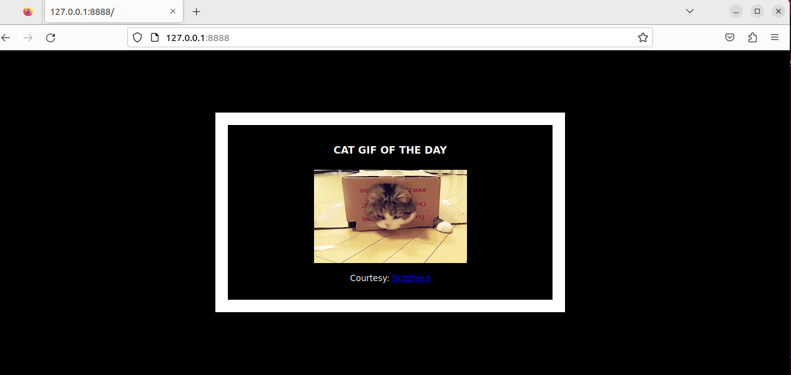
sudo docker run -d -p 8888:5000 dockerfile/myapp
http://127.0.0.1:8888/

Slide 31
Congratulations! You have successfully created your first docker image.

Slide 32
Reference
https://www.aquasec.com/cloud-native-academy/docker-container/100-best-docker-tutorials/
https://docker-curriculum.com/#hello-world
https://www.educba.com/docker-commands/
https://docker-curriculum.com/#our-first-image

